Slide 1
Module 7 Guidance Notes (7.2) Structs
ENGG1340/COMP2113 Computer Programming II/Programming Technologies

Slide 2
What are we going to learn?
Structures
Definition, Declaration, Initialization
Member variables
Nested structures
Array of structures
Structure and Functions
Structure with member functions (C++ only)

Slide 3
Structures
A structure is a collection of one or more variables grouped together under a single name
The data elements in a structure are known as its member variables (or simply members), which can be of different types
Structures help organizing complex data
Allow a group of related variables to be treated as a single unit instead of separate entities
Structures act like any basic data type
May be copied and assigned to variables
May be passed to and returned by functions
Student Record
uid (int)
assign 1 marks (int)
assign 2 marks (int)
quiz 1 marks (int)
quiz 2 marks (int)
final marks (int)
total marks (double)
grade (char)

Slide 4
Definition
In C++, a structure is defined using the keyword struct, followed by a structure tag, a list of member variables (with types and identifiers) enclosed within a pair of braces { }, and a semicolon ;
Keyword to specify that this is a structure
struct Point {
double x;
double y;
};
struct Student {
int id;
string name;
char sex;
};
Name of the structure
Members of the structure
Must end with a ;

Slide 5
Definition
Examples
struct Product {
int productID;
double price;
};
struct Point {
double x;
double y;
};
struct Circle {
double x, y;
double r;
};
member variables
Members of different structures can have the same name

Slide 6
Declaration
Structure variables can be declared just as what you do for the basic data types (e.g., int, char)
struct data type
x
p1
y
Point p1;
Student s1, s2;
id
s1
name
sex
variable names
id
s2
name
sex
memory

Slide 7
Initialization
A structure variable can be initialized in its declaration:
Point p1 = { 1.0, 2.0 };
Student s1 = { 301323549, "Amy Siu", 'F' };
Student s2 = s1;
Can be initialized with another variable of the same structure data type
Order of the members must be the same as that specified in the definition
Point p2 = { 1.0, 2.0, 3.0 };
Point p3 = { 1.0 };
✗
A compilation error will be generated, since there are more values than the number of members
There are fewer values than the number of members, remaining variables are set to zero of their data type.
(x = 1.0, y = 0.0 )

Slide 8
Member Variables
A member variable can be used just as other variables of the basic data types
We may use the dot operator . to access the member variables of a structure
What are the values of all the member variables?
Point pt1 = { 1.0, 2.0 };
Point pt2 = pt1;
pt1.x *= 2.0; // pt1.x = pt1.x * 2.0
pt1.y /= 2.0; // pt1.y = pt1.y / 2.0
pt2.x++; // pt2.x = pt2.x + 1
pt2.y--; // pt2.y = pt2.y – 1
result
pt1.x = 2.0
pt1.y = 1.0
pt2.x = 2.0
pt2.y = 1.0
the dot operator
Student s1 = { 301323549, "Amy Siu", 'F' };
int l = s1.name.length();
What is the value of l?
l = 7
a string variable

Slide 9
Member Variables
What is the data type of each of the following?
s1.id
s1.sex
s1.name
s1
Student.GPA
s1.GPA
s2.GPA
Example
struct Student {
int id;
string name;
char sex;
double GPA;
};
Student s1;
int
char
string
Student
invalid. Student is a data type, not a variable
double
invalid. s2 is undeclared.

Slide 10
Operators
Structure variables do not work with arithmetic (+/-), relational (>/<), equality (==) and logical operators (&&/||) by default
because struct is user-defined
All expressions below are therefore invalid
Point pt1 = {1.0, 2.0}, pt2 = {3.0, 5.0};
Point pt3 = pt1 + pt2;
bool b = pt1 > pt2;
bool c = pt1 == pt2;
bool d = pt1 && pt2;
✗
The only operator that we may use is the assignment (=) operator

Slide 11
Assignment
The assignment operator = can be used for copying a struct to another
Example:
Point p1 = {1.0, 2.0}, p2;
p2 = p1;
is equivalent to
p2.x = p1.x;
p2.y = p2.y;
Point p1 = {1.0, 2.0}, p2;
p2.x = p1.y;
p2.y = p1.x;
p1 = p2;
cout << p1.x << ' ' << p1.y << endl;
Screen output
2 1

Slide 12
Nested Structures
Structures can be nested, which means that a structure can be a member of another structure
Examples:
tr1.p1.x = 1.0
tr1.p1.y = 2.0
tr1.p2.x = 3.0
tr1.p2.y = 4.0
tr1.p3.x = 5.0
tr1.p3.y = 6.0
tr2.p1.x = 1.0
tr2.p1.y = 2.0
tr2.p2.x = 3.0
tr2.p2.y = 4.0
tr2.p3.x = 5.0
tr2.p3.y = 6.0
struct Triangle {
Point p1, p2, p3;
};
Triangle tr1 = {{1.0, 2.0}, {3.0, 4.0}, {5.0, 6.0}};
Triangle tr2 = {1.0, 2.0, 3.0, 4.0, 5.0, 6.0};
tr2.p1.x += tr1.p2.x;
tr2.p1.y += tr1.p2.y;
tr2.p2 = tr1.p3;
tr2.p1.x = 4.0
tr2.p1.y = 6.0
tr2.p2.x = 5.0
tr2.p2.y = 6.0

Slide 13
Size of Structure
Reference Only
struct structA
{
char c;
double d;
int s;
};
struct structB
{
double d;
int s;
char c;
};
The memory size needed for a structure may not necessarily be the total memory sizes of its variables, and the memory size may differ depending on the order of the variables too!
Try out struct_size.cpp
int main()
{
cout << "sizeof(structA) = " << sizeof(struct structA) << endl;
cout << "sizeof(structB) = " << sizeof(struct structB) << endl;
return 0;
}
Given that the sizes of char, int, double are 1, 4, 8 bytes, respectively, what are the sizes of structA and structB?

Slide 14
Size of Structure
Reference Only
struct_size.cpp
int main()
{
cout << "sizeof(structA) = " << sizeof(struct structA) << endl;
cout << "sizeof(structB) = " << sizeof(struct structB) << endl;
return 0;
}
struct structA
{
char c;
double d;
int s;
};
struct structB
{
double d;
int s;
char c;
};
You will find that structA takes up 24 bytes while structB takes up 16 bytes only.
The difference is due to how data is aligned and padded in the memory.
In a 32-bit machine, data is stored with a 4-byte alignment and the different ordering will result in different padding. For more discussions, see: https://www.geeksforgeeks.org/data-structure-alignment/
You will learn more about this in the Computer Organization course.

Slide 15
Arrays of Structures
Consider storing student records, we may use parallel arrays to store students' info and their marks :
This is more often done using an array of struct, so that each element is a structure containing all the info for a student.
const int MAX = 200;
string name[MAX];
int subclass[MAX] = {0};
int year[MAX] = {0};
int month[MAX] = {0};
int day[MAX] = {0};
double mark[MAX] = {0};
Elements of the same index store the info for a particular student (e.g., name[7], subclass[7], year[7], …)

Slide 16
Parallel Arrays
name
"John" | "Mary" | "Smith" | "Jordan" | "Bruce"
subclass
0 | 1 | 1 | 2 | 0
string name[5];
int subclass[5];
int year[5];
int month[5];
int day[5];
double mark[5];
year
2014 | 2014 | 2014 | 2014 | 2014
month
10 | 10 | 10 | 10 | 11
day
28 | 22 | 29 | 12 | 1
mark
80.5 | 66.5 | 99 | 86.5 | 70.5
A record is referred to by name[i], subclass[i], year[i], month[i], day[i], mark[i]
Array of Structures
student
"John"
0
2014
10
28
80.5
"Mary"
1
2014
10
22
66.5
"Smith"
1
2014
10
29
99
"Jordan"
2
2014
10
12
86.5
"Bruce"
0
2014
11
1
70.5
struct Student_rec {
string name;
int subclass;
int year;
int month;
int day;
double mark;
};
Student_rec student[5];
A record is referred to by student[i].name, student[i].subclass, student[i].year, student[i].month, student[i].day, student[i].mark

Slide 17
Arrays of Structures
Student records stored in an array of struct:
const int MAX = 200;
struct Student_rec {
string name;
int subclass;
int year;
int month;
int day;
double mark;
};
Student_rec student[MAX];
What is the data type of each of the following?
student
student[2]
student[4].year
Student_rec.day
student.mark
Array of Student_rec
Student_rec
int
invalid. Student_rec is a data type, not a variable
This declares an array of size MAX, each element being a Student_rec.
invalid. student is an array, not a struct and hence no member to access
array_structure.cpp

Slide 18
Arrays of Structures
Examples:
// to print out the student records
for (int i = 0; i < 10; ++i) {
cout << student[i].name << ' '
<< student[i].subclass << ' '
<< student[i].mark << endl;
}
// to copy student records
student[10] = student[5];
Think about this: How would you copy student records if they are stored using parallel arrays?
Take a look at array_structure.cpp
which serves the same purpose as processmarks.cpp but using arrays of structures instead.

Slide 19
Structures and Functions
Structure variables can be passed to a function either by value or by reference, and can be returned by a function like regular variables
Pass-by-value
// distance between two points p and q
double point_distance( Point p, Point q ) {
double dx = p.x – q.x;
double dy = p.y – q.y;
return sqrt( dx * dx + dy * dy );
}
spoint.cpp
Compare with this:
// distance between two points (x1, y1), (x2, y2)
double distance( double x1, double y1, double x2, double y2) {
…
}
Using structure as parameters is clearer and more structural

Slide 20
Structures and Functions
Pass-by-reference
// swap two points p and q
void swap( Point &p, Point &q ) {
Point temp = p;
p = q;
q = temp;
}
// get a point from user input
Point input_point() {
double x, y;
cin >> x >> y;
Point p = { x, y };
return p;
}
Return a structure
spoint.cpp

Slide 21
Programming Problem 1
072001
Add a function named midpoint() in spoint.cpp, which returns the mid-point of two 2D points.
Add a function named shrink_line() in spoint.cpp, which shrink a line defined by two endpoints as follows:
// mid-point of two points p and q
Point midpoint( Point p, Point q ) {
…
}
What is the function prototype?
p
// shrink a line with endpoints p and q
void shrink_line( Point &p, Point &q ) {
…
}
What is the function prototype?
d/4
3d/4
q
d

Slide 22
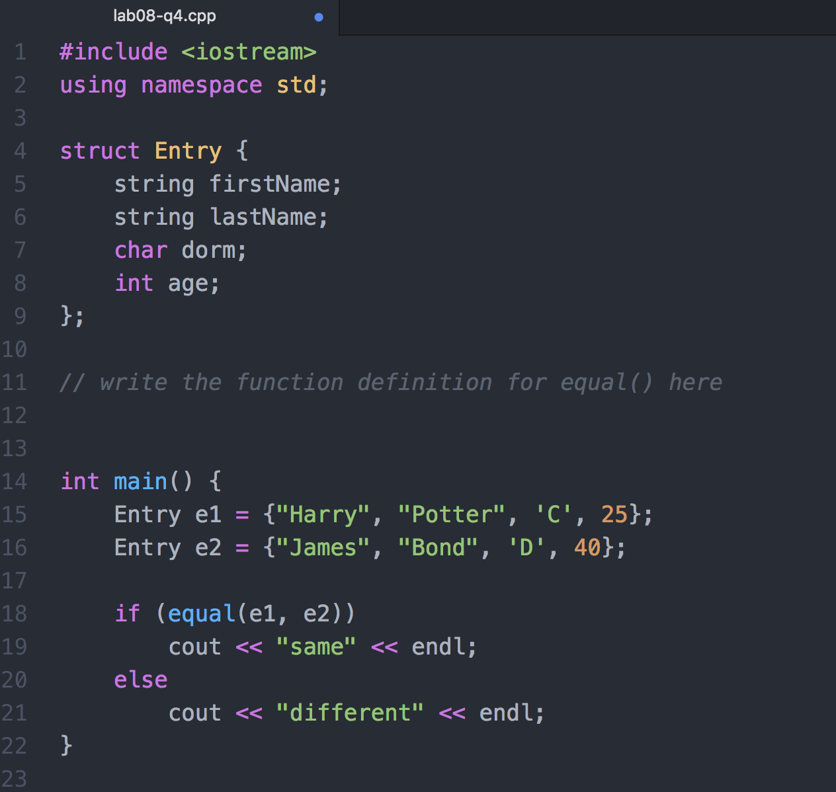
Programming Problem 2
072002
Fill in the body of the equal function below. The function will return true if the member variables of the structure contain the same data and false otherwise.

Slide 23
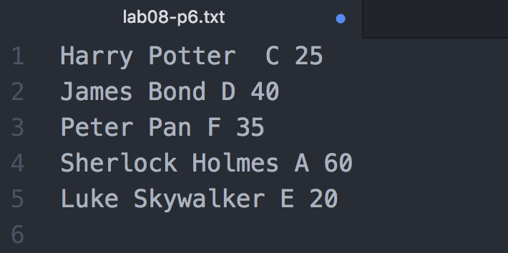
Programming Problem 3
072003
Read a text file that consists of a list of Entry.(see Problem 2). Here is an example:
Save the entries as an array of type Entry. Sort the list by age and output the result on the screen. You may assume that there are at most 100 entries in the text file.

Slide 24
More examples on struct and function
struct Circle {
double x, y;
double r;
};
Consider struct Circle, and we are to implement the following three functions:
Function 1: To compute the area of a circle
Function 2: To enlarge a circle (i.e., increase its radius)
Function 3: To check whether a circle overlaps with another circle
What would possibly be the function prototypes for the above functions?
Think about the input and output of these functions.

Slide 25
More examples on struct and function
Function prototypes
Function 1: To compute the area of a circle
Input: a circle, output: the area
Function 2: To enlarge a circle (i.e., increase its radius)
Input: a circle, the increment in radius; the circle radius needs to be modified
Function 3: To check whether a circle overlaps with another circle
Input: two circles, output: whether they overlaps
double CircleArea(Circle c);
void EnlargeCircle(Circle &c, double radius_to_add);
bool IsCircleOverlap(Circle c1, Circle c2);

Slide 26
More examples on struct and function
struct Circle {
double x, y;
double r;
};
Implementation of the three functions
Function 1: To compute the area of a circle
double CircleArea(Circle c) {
const double PI = 3.14159265358979323846;
return PI * c.r * c.r;
}
circle.cpp

Slide 27
More examples on struct and function
struct Circle {
double x, y;
double r;
};
Implementation of the three functions
Function 2: To enlarge a circle (i.e., increase its radius)
void EnlargeCircle(Circle &c, double radius_to_add) {
c.r += radius_to_add;
}
circle.cpp

Slide 28
More examples on struct and function
struct Circle {
double x, y;
double r;
};
Implementation of the three functions
Function 3: To check whether a circle overlaps with another circle
bool IsCircleOverlap(Circle c1, Circle c2) {
double dx = c1.x - c2.x;
double dy = c1.y - c2.y;
double centre_dist = sqrt(dx*dx + dy*dy);
return (centre_dist <= (c1.r + c2.r));
}
circle.cpp
Now, we have implemented a structure Circle and also three functions that operates on the structure. As mentioned, the structure with member variables only and all three functions are valid in both C and C++.

Slide 29
More examples on struct and function
Example use of the three functions
int main() {
Circle p = {1,1,2}, q = {2,2,1};
EnlargeCircle(p, 5);
cout << "new radius of p: " << p.r << endl;
cout << "area of q: " << CircleArea(q) << endl;
cout << "p and q overlap? " << (IsCircleOverlap(p, q) ? "Yes" : "No") << endl;
return 0;
}
circle.cpp

Slide 30
Structs with Member Variables Only
The example structs which we can come across so far contain member variables only:
In C, a struct can only contain member variable.
In C++, you may also define member functions for struct.
struct Student {
int id;
string name;
char sex;
double GPA;
};
struct Product {
int productID;
double price;
};
struct Point {
double x;
double y;
};
struct Circle {
double x, y;
double r;
};
So these structure definitions are valid in both C and C++.

Slide 31
Structs with Member Functions
Let’s take a look at how we can implement member functions for structure in C++.
Again consider the structure Circle:
We can implement a member function for the structure to compute the area of the circle.
struct Circle {
double x, y;
double r;
};

Slide 32
Structs with Member Functions
struct Circle {
double x, y;
double r;
double Area() {
const double PI = 3.14159265358979323846;
return PI * r * r;
}
};
circle_structfunc.cpp
Note how we may define a function within a struct body.
The member function can access the member variable of the structure.
Therefore, the function Area() does not need to take any input, and it can use the member variable r directly to compute the area.
Compare this to the implementation of Function 1.

Slide 33
Structs with Member Functions
We may also write only the function prototype inside the struct and move the function definition move outside of the struct:
struct Circle {
double x, y;
double r;
double Area();
};
double Circle::Area()
{
const double PI = 3.14159265358979323846;
return PI * r * r;
}
The scope resolution operator "::" indicates that this function Area() belongs to the structure Circle
circle_structfunc.cpp

Slide 34
Structs with Member Functions
To implement Function 2 as a member function of Circle:
struct Circle {
double x, y;
double r;
double Area();
void EnlargeCircle(double radius_to_add) {
r += radius_to_add;
};
}
double Circle::Area()
{
const double PI = 3.14159265358979323846;
return PI * r * r;
}
We’ll just leave this member function here inside the struct body, without moving it out
Update r directly
circle_structfunc.cpp

Slide 35
Structs with Member Functions
To implement Function 3 as a member function of Circle:
struct Circle {
double x, y;
double r;
double Area();
void EnlargeCircle(double radius_to_add) {
r += radius_to_add;
};
bool IsOverlap(Circle c);
};
bool Circle::IsOverlap(Circle c) {
double dx = x - c.x;
double dy = y - c.y;
double centre_dist = sqrt(dx*dx + dy*dy);
return (centre_dist <= (r + c.r));
}
Check if this circle (i.e., the circle whose member function is called) overlaps with the input circle c
circle_structfunc.cpp

Slide 36
Structs with Member Functions
Example use of the three member functions
int main() {
Circle p = {1,1,2}, q = {2,2,1};
p.EnlargeCircle(5);
cout << "new radius of p: " << p.r << endl;
cout << "area of q: " << q.Area() << endl;
cout << "p and q overlap? " << (p.IsOverlap(q) ? "Yes" : "No") << endl;
return 0;
}
Again we use the dot operator . to access the member functions of a structure
circle_structfunc.cpp

Slide 37
Classes
Important: This topic on “Classes” are optional but highly recommended. Students are not required to write code to implement a class at this stage, but it would be helpful if you can understand codes for class implementation.

Slide 38
Abstract Data Types
Optional but Recommended
Sometimes we would like a certain data type to be associated with specific operations.
Integers: +, −, *, /
Points: translate, distance
Strings: length, substring, replace
An abstract data type (ADT) encapsulates both the data and the methods (i.e., operations) of into a package, so that users are restricted to perform only certain operations against the data inside. Also, the implementation details (how the data is stored, how the operations are carried out) of an ADT is hidden from the user (aka encapsulation or information hiding).

Slide 39
Abstract Data Types
Optional but Recommended
When you want to use an ADT to solve a problem, we only care about what can be done with them (i.e., the operations / interface ), but not how they are done (i.e., the implementation).
string s = "I am mysterious";
cout << s.length() << endl;
cout << s.substr(0, 5) << endl;
cout << s.find("am") << endl;
When you use a string object, do you need to know how the string is stored internally, and how a substring is extracted by the .substr() function?
As a user for the string class, we only care about what operations are available.
This is like when we use a function, we only need to know what it does by looking at its prototype, e.g., double sqrt( double x); but we don't care about how it comes up with the result.

Slide 40
Abstract Data Types
Optional but Recommended
Compare with this: When we use struct Point, we need to know how the coordinates are stored if we need to write a function to do anything on them.
struct Point {
double x;
double y;
};
// distance between two points p and q
double point_distance( Point p, Point q ) {
double dx = p.x – q.x;
double dy = p.y – q.y;
return sqrt( dx * dx + dy * dy );
}
What if we later change our mind and want to use an array of 2 doubles instead to store x and y? Then any function making use of Point (e.g., point_distance()) will need to be modified.
struct Point {
double v[2];
};
Hence, it would be great if an ADT can provide “interfaces” for accessing its data, so other developers who want to use the ADT do not need to care about the internal representation/implementation (i.e., even if these changes, one doesn’t need to change his code that uses the ADT).

Slide 41
Classes
Optional but Recommended
ADTs are implemented using classes in C++. A class contains data (member variables) and methods (member functions) and is divided into two sections.
Public Section
Data/methods here are accessible by the application program/code using an object of this class.
Abstraction of the ADT
member functions
class Point {
public:
double getX();
double getY();
double distance(Point & p);
void translate(Point & p);
private:
double x;
double y;
};
The public and private sections may contain both member variables and functions. However, we should avoid defining member variables in the public section in order to enforce access of ADT internal data via member functions. Hence the member functions serve as the “interfaces” which we mentioned earlier. You will learn more about class design in the Object Oriented Programming (OOP) course.
Private Section
Data/methods here can only be accessible by the member functions of the same class.
Implementation of the ADT
member variables
For C++ struct, member variables and functions are by default, while they are by default private for class.

Slide 42
Class Definitions
Optional but Recommended
A member function can access the private variable of the class. Since it is defined under the public section, others can have “access” to the private variables via this function.
Keyword for defining a class
class Point {
public:
double getX() { return x; }
double getY() { return y; }
void setCoord(double s, double t) {
x = s;
y = t;
}
double distance(Point & p);
void translate(Point & p);
private:
double x;
double y;
};
Member function definitions
Access specifier
Member function prototypes. Note that these functions are not defined yet (i.e., we need to define them somewhere else).
As designer of a class, you may choose whether to include the definition or just the prototype for a member function inside a class definition. There are some design considerations, but we won’t go in the details here (again we’ll leave it to the OOP course).
Member variable declarations
Ends with a ;

Slide 43
Member Functions
Optional but Recommended
Member functions can be defined outside the class body:
The function distance() is a member function of Point. Suppose we have a variable (object), say “q”, of type Point. Then the distance() function of “q” can access the x, y coordinates of “q”. Here, “this point” means the point “q”.
The scope resolution operator "::" indicates variable/function membership of a class
Recall – std::endl
// distance between this point and point p
double Point::distance(Point & p) {
double dx = p.x – x;
double dy = p.y – y;
return sqrt( dx * dx + dy * dy);
}
// translate this point by an offset p
void Point::translate(Point & p) {
x += p.x;
y += p.y;
}
Member variable "x" of the input Point "p"
Member variable "x" of "this" Point

Slide 44
Class Declaration
Optional but Recommended
To declare an object (variable) for a class:
Each object can then retain their own values for each member variables
Class_name object_name1, object_name2, …;
Point p1, p2;
string s1("abc");
Since class are just user-defined data types, you can declare just like how you declare an int, a double, etc.
Examples:
"p1", "p2" are Point objects, "s1" is a string object (YES, string is just a class)
p1
p2
p1.setCoord(1, 2);
p2.setCoord(4, 5);
Examples:
x
1
x
4
y
2
y
5

Slide 45
Multiple Files Compilation for Class Implementation
Optional but Recommended
It is a common practice to put the codes for a class in a separate file, so that the class can be reused by another file or program.
We also further separate the definition and implementation of a class in .h and .cpp files, respectively. Doing so allows users of a class to focus only on the class interface (which defines how to use the class) in the header file (.h)
#include "point.h"
int main()
{
Point p, q;
…
p.distance(q);
…
return 0;
}
class Point
{
public:
…
private:
…
};
double Point::distance(Point & p) {
…
}
void Point::translate(Point & p)
{
…
}
main.cpp
point.h
point.cpp
Main program
Class interface
Class implementation
Any other program that wants to use Point can just include "point.h".
Check the sample programs and also the Makefile for this example.

Slide 46
CHALLENGES
Optional.
For those who would like to challenge yourselves. Even for those of you who are beginners in C++ programming, it’s highly recommended for you to take a look at these problems and try to tackle them as well.
You are welcome to discuss these problems in the Moodle forum.

Slide 47
Challenge 1
073001
Write a little library system for storing and searching books with using a text file. The data should include name, author, call number and subject. No restriction on output format.
You may start with the following struct definition, function prototypes and main function design:

Slide 48
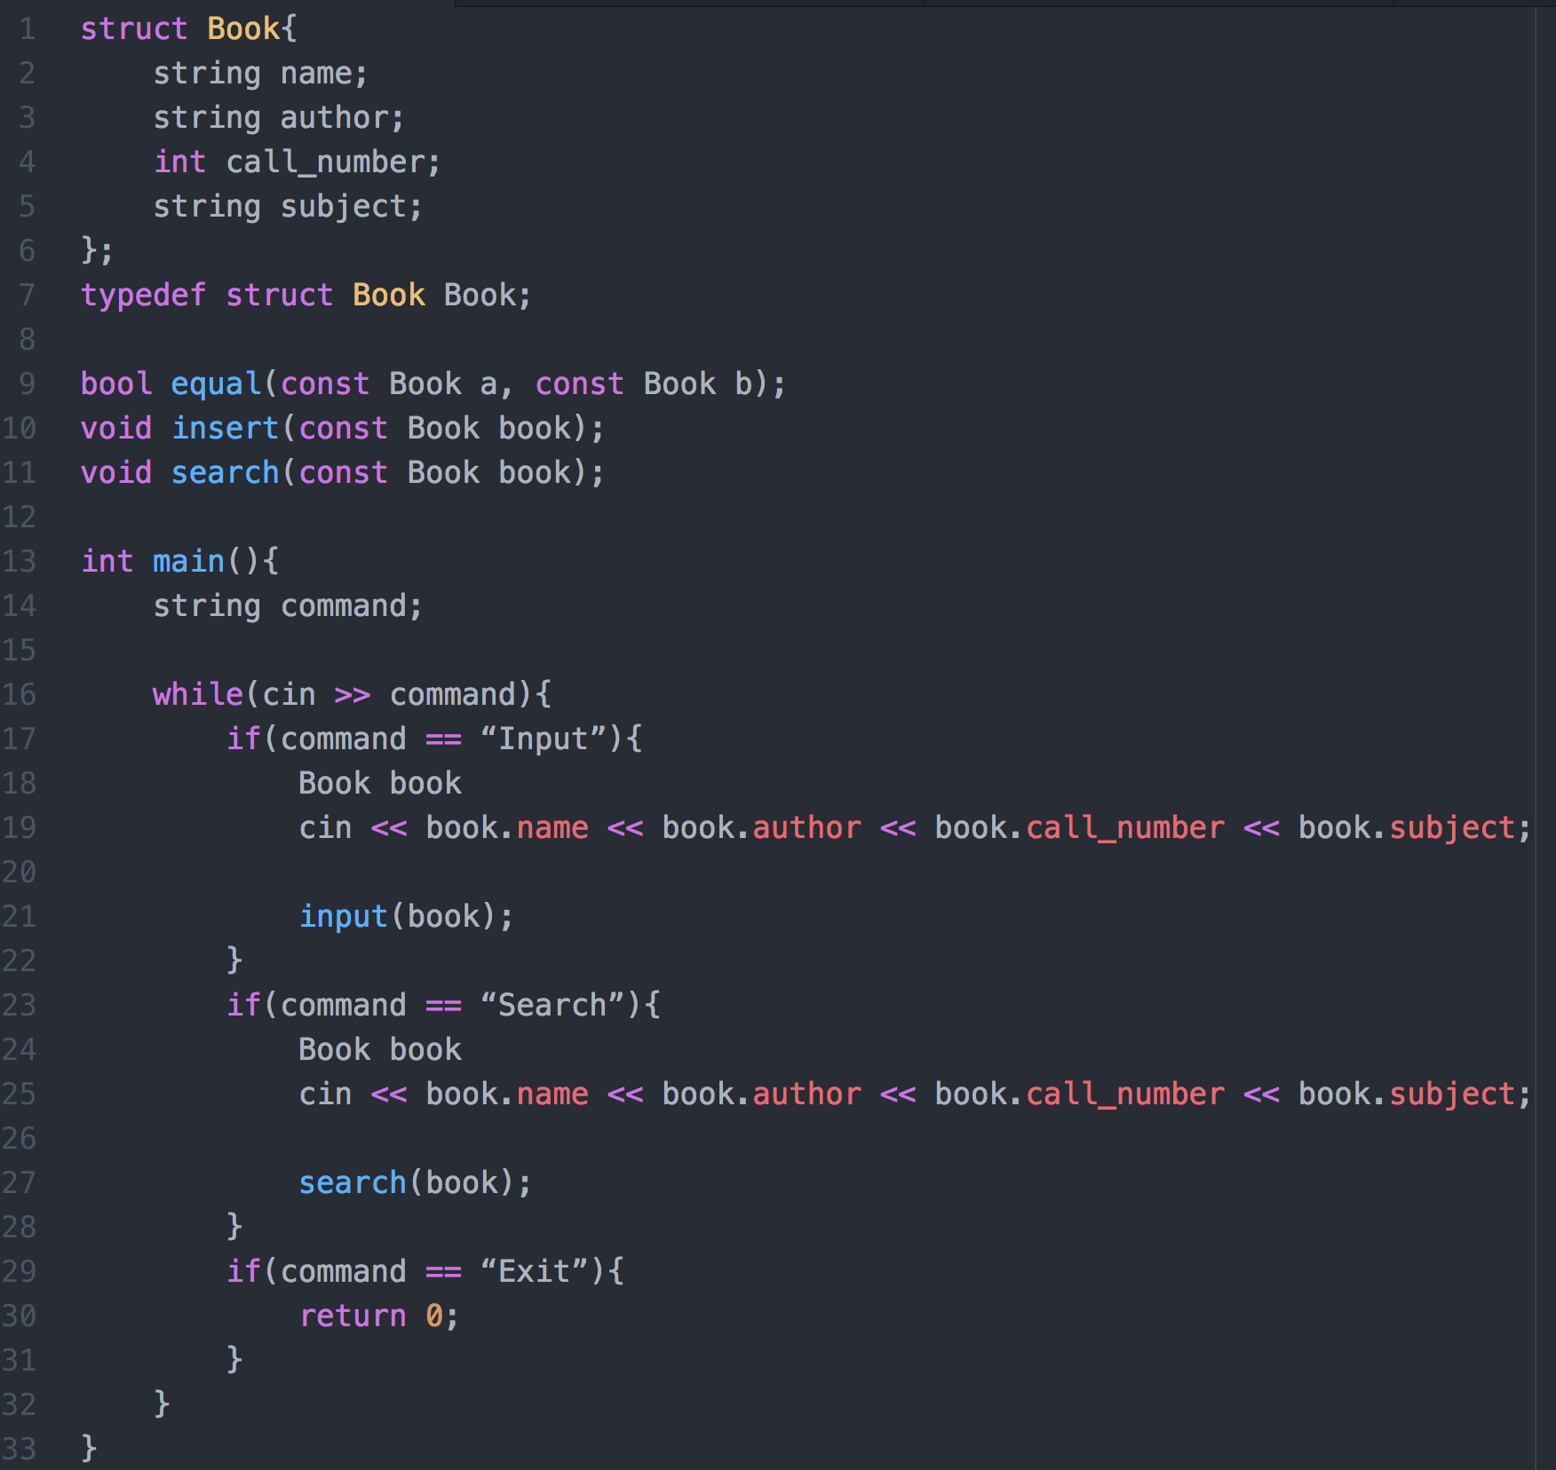
Challenge 1
073001

Slide 49
Challenge 2
073002
This question is on file I/O and string manipulation.
Write a program to read a file and report the number of occurrences of each word in the file. Your program will not distinguish between upper- and lower-case words. E.g., “hello”, “Hello”, “HELLO” are the same. The words must be output in lowercase and sorted in ascending order of their frequencies. Words with same frequency are ordered lexicographically.
Example:
Contents of input file: Hello, where are you going to? Are you going to school to … say hello?
Your program output: say 1 school 1 where 1 are 2 going 2 hello 2 you 2 to 3
Hint: By including <cctype> you can use the function ispunct() to test whether a character is a punctuation or not.

